Slide 1

Measuring Mechanical Properties of Thin Optical Coatings
Elaine Rhoades
Mentors: Dr. Zanolin, Embry-Riddle Aeronautical University
Dr. Gretarsson, Embry-Riddle Aeronautical University
April 12, 2014 NASA Space Grant Symposium

Slide 2
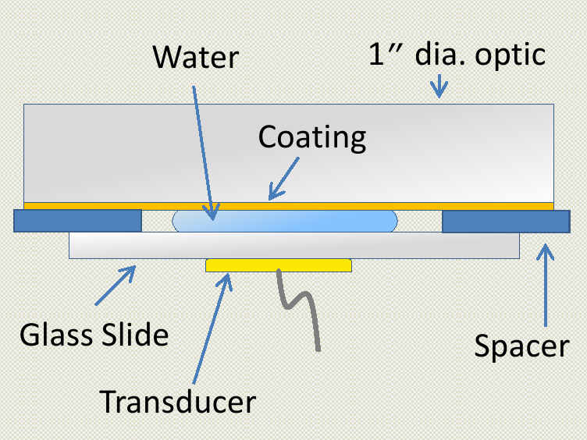
Experimental Setup
Use a transducer to emit and sense reflections of a 0.4 GHz, 10 ns acoustic pulse from the surface of a sample.
Materials affect the reflected amplitude differently
Reflected amplitude contains information about the Young’s Modulus
Image credit: Dr. Andri Gretarsson, ERAU

Slide 3
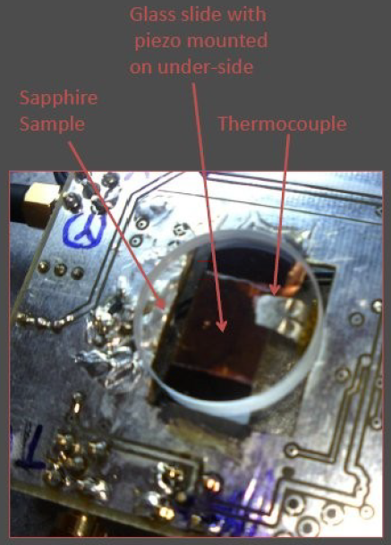
Experimental Setup
Water absorption likely has a temperature dependence
Experimental setup has a thermocouple inserted between the piezo and spacers, which allows us to monitor the water’s temperature during data collection
Photo credit: Dr. Andri Gretarsson, ERAU

Slide 4
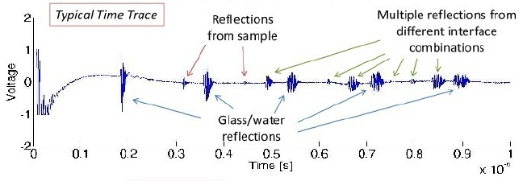
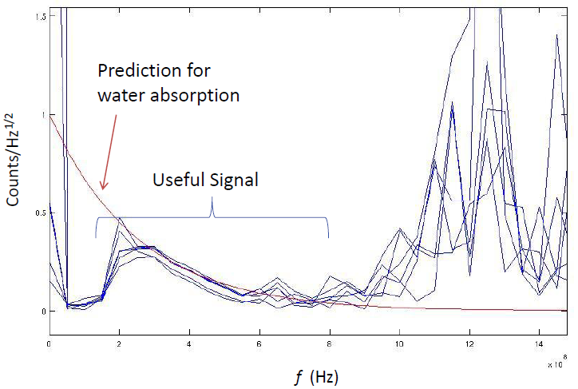
Data
Remove noise in the signal by band limiting (cut |FFT|)
Exponential form results from water
absorption and
other losses
Image credit: Justin Weber, ERAU

Slide 5
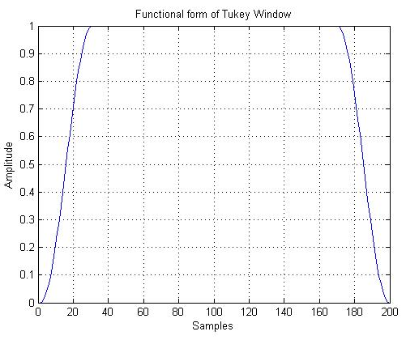
Updates to the acoustics analysis
Automated the data windowing process
Introduced the use of a Tukey window to remove high frequency components
Introduced error propagation

Slide 6
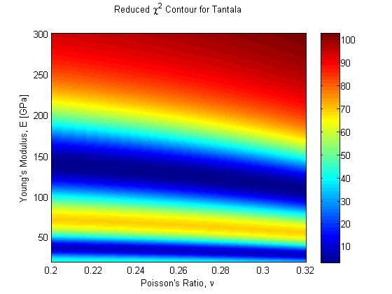
Y Estimate Depends on σ

Slide 7
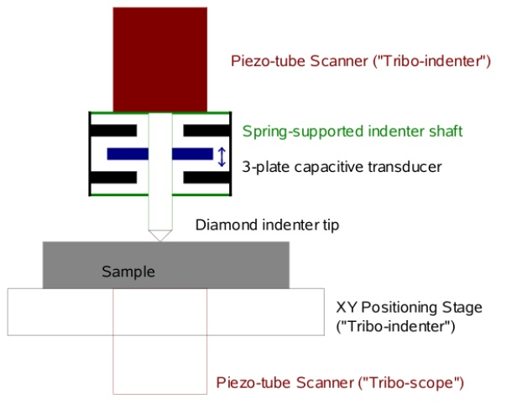
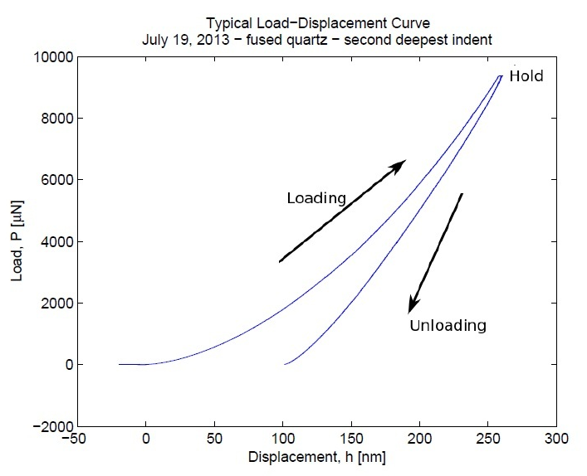
Nanoindentation

Slide 8
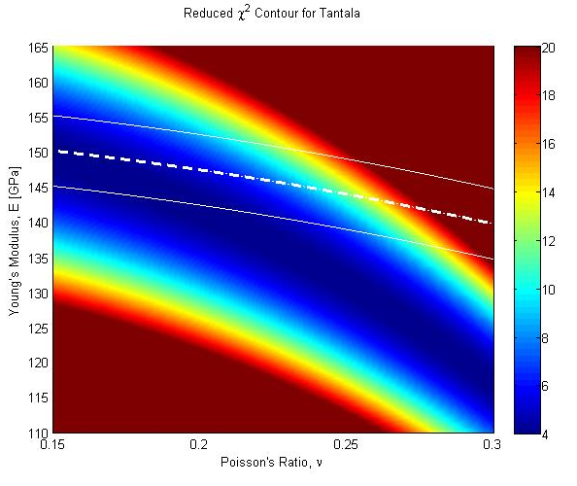
Comparison of Acoustics and Nanoindentation
Colored background is the acoustics chi-squared plot
Bold dashed line is the nanoindentation fit
Solid white lines are the errors in the nanoindentation fit

Slide 10
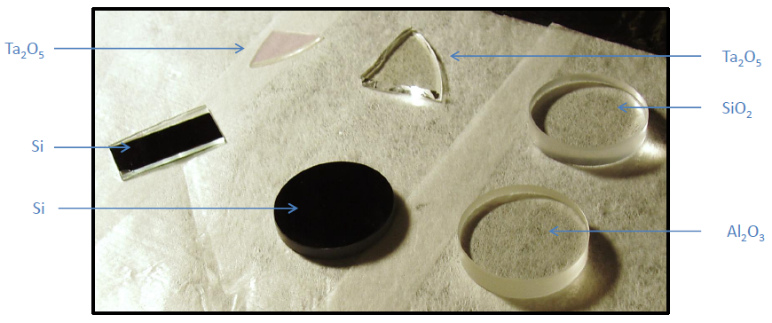
Samples
Silica
Sapphire
Silicon cantilevers (borrowed from Glasgow group)
Silicon windows
Single-layer tantala coatings, base silica
Photo credit: Dr. Andri Gretarsson, ERAU

